Slide 1

Data Analysis Portfolio
Shreejit Cheela

Slide 2
Table of contents
01
02
03
04
About me
Professional Background
Projects
Summary

Slide 3
01
About me.

Slide 4

About me
I am known to be gracious and a charmer. I encourage myself by taking everyone ahead of me as a
competition. I thrive to do everything I do selflessly and as flawlessly as possible. I believe I am a learner and
always trying to be a better version of myself no matter what it takes.
Getting started with Machine Learning as my domain of interest. also interested in Data Analysis, Data Science, Artificial Intelligence, Data Mining, Deep Learning, Web Development, Cybersecurity.
Born: 24/11/2002
Living in: Hyderabad, Telangana, India.

Slide 5
My qualities
Agile
Versatile
Multitasking
Quick, Resourceful and Adaptive
Flexible and able to do different kinds of things
A person who can perform or manage many tasks at the same time
Optimism
Overcoming
Honesty
Always have a positive hope for my future
Move on and move forward
Fairness and straightforwardness of conduct
Empathic
Perseverance
Loyalty
Aware of other’s feelings and my boundaries
Never gonna give up!
Unswerving and faithful

Slide 6
Professional Background
02

Slide 7

Professional Background
Hello!
As of now, I am in my 3rd year of Bachelor of Technology in the field of Computer Science and Engineering in Artificial Intelligence and Machine Learning at Vignana Bharathi Institute of Technology, Ghatkesar, with an aggregate of 8.8 CGPA (till 4th semester/2-2).
Only having theoretical knowledge was never enough, I strongly believe I understand better when there is a Hands-On, with that being said, I started off my career as a Student Intern at AICTE NEAT learning the AWS AIML tools and basics of Cloud Computing. Then at YBI Foundation, solved more than 15 real world problems using Machine Learning Algorithms. Next, I interned at RineX in association with IIT Roorkee and Cognizance where I got experience all the different fields in AI and ML with more than 10 real world projects. Presently I am interning at Trainity in the field of Data Analysis along with that I am also a Junior Associate at EpsilonPi, the Machine Learning forum at VBIT.
Having Research and Projects as my two ways of learning, I am enthusiastic about the field of Machine Learning, and would welcome the opportunity to bring my strong communication skills, problem solving, and analytical thinking to the best of my ability. I always believe that I am a Learner and strive to welcome new opportunities..
Technical Skills: C, Java, Python, SQL, HTML and
CSS, JavaScript, MS office.
Shreejit Cheela
Student/Intern

Slide 8
03
Projects
Tasks:
Data Analytics Process
Instagram User Analytics
Operation & Metric Analytics
Hiring Process Analytics
Final Projects:
IMDB Movie Analysis
Bank Loan Case Study
XYZ Ads Airing Report
ABC Call Volume Trend

Slide 9
Tasks
3.1
Data Analytics Process
Instagram User Analytics
Operation & Metric Analytics
Hiring Process Analytics

Slide 10
Task 1: Data Analytics Process
Data Analytics is one such process which everyone has to use in their daily proceedings. Data Analysis is the process of systematically applying statistical and/or logical techniques to describe and illustrate, condense and recap, and evaluate data. Data Analytics Process is like a life cycle which is used to perform Data Analysis.
Data Analytics Life Cycle
Plan: We first decide which things I need before going to market . Is it a shirt , jeans , footwear etc.
Prepare: Next I need to check how much I am willing to spend and how to get that money.
Process: Then I need to check how much I want from the data. Like if I am going to buy footwear what do I want - slippers / shoes / sandals etc.
Analyze: You obviously won't buy things which are out of trend, Also you need to check does the jeans which you have and the color of t-shirt you want to buy, will it make a good combination.
Share: Now you communicate your idea to the shopkeeper to find the best suitable fit for you.
Act: Then you finally buy it!
Findings/Conclusions:
Firstly, we saw how Biometrics and Health Care sector uses Data Analysis.
Then, learnt what Alpha Fold is and how it uses AI to generate structures which is an advanced application of Data Analytics.
Some other real life examples are: Automatic Weather Forecasting, Self Driving Cars etc. are some other examples which work using Data Analytics as a base.

Slide 11
Task 2: Instagram User Analytics
In this project, we need to peruse the given data and information in order to help find the solutions for the given situations. The problems elaborate various situations that may arise while analyzing data that is generated by Instagram users in a particular period of time. The project involves multiple tables namely “users”, “comments”, “follows”, “likes”, “photo_tags”, “photos”, “tags” which belong to the same dataset: “ig_clone”. Clearly, the dataset is generated by cloning the data generated by Instagram. Here, we refer to these situations as queries.
Tasks or Assignments:
All the tasks were grouped into two main categories which are Marketing and Investor metrics. All the questions under these types are real time problems or issues we face while we are working on such tasks. I used SQL: Structured Query Language for solving these problems and executed the query on MySQL.
Insights
Data means a series of records of values which are collected over a period of time and stored in an organized manner. When data is processed and some required value is fetched out of it then it is called Information.
Data is stored in Databases by Data Scientists using DDL [Data Definition Language] commands and is analyzed by Data Analysts using DML [Data Manipulation Language] commands of SQL.
SQL is a language which helps us to manage, manipulate and maintain databases, it abbreviates Structured Query Language whereas, MySQL is a software or a tool which provides a platform to run and execute SQL commands.

Slide 12
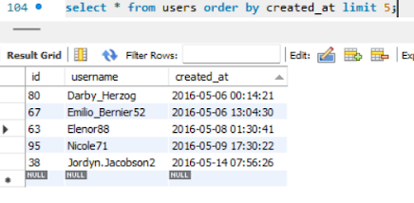
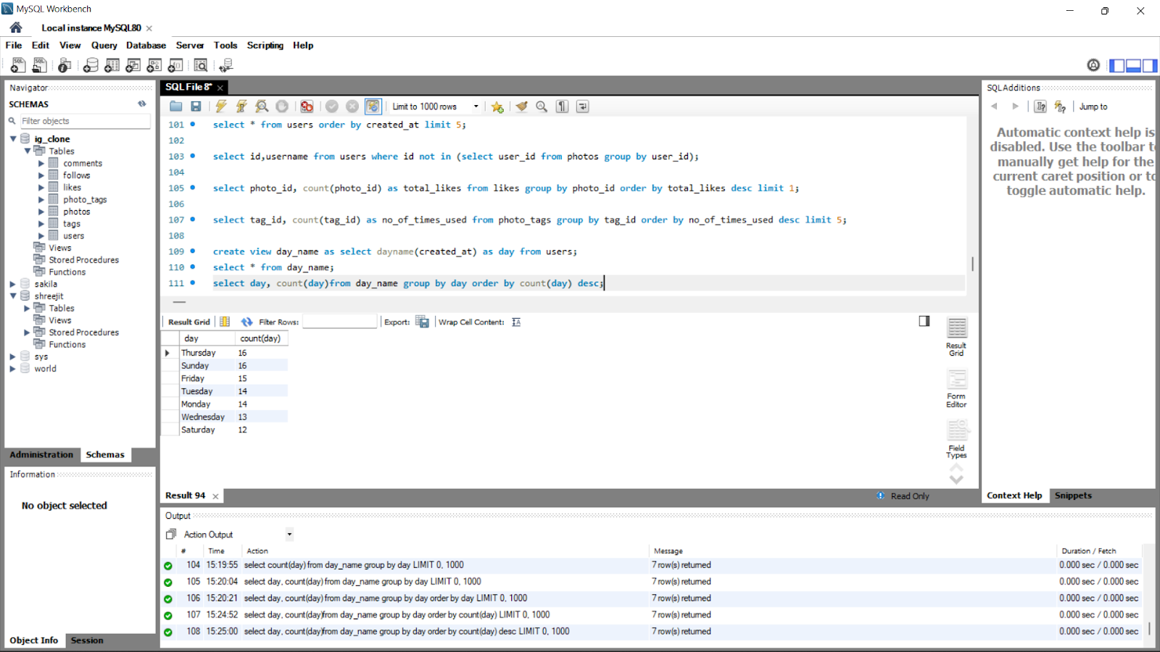
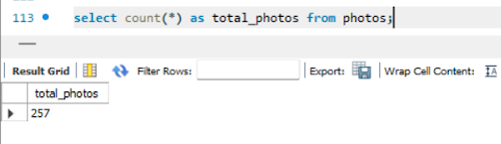
Here are some of the solutions
For complete solution of Task 2: https://docs.google.com/document/d/1bcxspfHvxhtCAeQbxX7fSuMBu0pt6Vy0QDrLszVAH8s/edit?usp=sharing

Slide 13
Task 3: Operation Analytics and Investigating Metric Spike
This project talks about Operational Analytics which I understand to be the analysis of a company's entire activities. This helps the business identify the areas where it needs to make enhancements. In such an analysis we closely collaborate with different teams involved like the ops team, the support staff, the sales team, etc. and assist them in drawing conclusions from the data they gather. Improved workflows, better communication and better automation are the results. As we are training to be a Data Analyst, one must be able to comprehend or help other teams understand questions, therefore analyzing metric spikes is also a crucial component of operational analytics. This type of study is often used to estimate the general rise or fall of a company's fortune because it is also one of the essential components of a business.
Tasks or Assignments:
I was asked to provide a detailed report of 2 case studies. The first one was all about operational analytics on job data which helped me improve my SQL skills for structuring and retrieving of data in tables. Then the second case study was to find the spike in various fields like User Engagement, User Growth etc. which is all under Investigating Metric Analysis.
Insights
All the problems refer to real-life situations which any data analyst would face while dealing with data. The attributes may differ but the application or approach will not change.
There are 2 case studies
Case Study 1 is data collected for a week and called job_data over different features.
Case Study 2 has 3 tables: users, events, email_events.
The tasks can be solved using concepts of window function (over()), date and time functions, also our previous DDL and DML commands.

Slide 14
Here are some of the solutions
CASE STUDY 2:
User Engagement: To measure the activeness of a user. Measuring if the user finds quality in a product/service. Calculate the weekly user engagement?
Sol: The user engagement for the week can be given by
select user_id, location, event_name
from events
Where (event_type=’engagement’) and (occured_at between dateadd(d,-7,convert(nvarchar(10),getdate(),101)) and convert(nvarchar(10),getdate(),101))
Order by user_id;
CASE STUDY 1:
Number of jobs reviewed: Amount of jobs reviewed over time. Your task: Calculate the number of jobs reviewed per hour per day for November 2020?
Sol: The task can be solved using the following query:
select count(*), DATE_PART('day',ds) as day, DATE_PART('hour',ds) as hour
from job_data
Group by hour,day;
For complete solution of Task 3: https://docs.google.com/document/d/1bcxspfHvxhtCAeQbxX7fSuMBu0pt6Vy0QDrLszVAH8s/edit?usp=sharing

Slide 15
Task 4: Hiring Process Analytics
In this project, we need to peruse the given data and information in order to help find the solutions for the given situations. The problems elaborate various situations that may arise while analyzing data that is generated by Instagram users in a particular period of time. The project involves multiple tables namely “users”, “comments”, “follows”, “likes”, “photo_tags”, “photos”, “tags” which belong to the same dataset: “ig_clone”. Clearly, the dataset is generated by cloning the data generated by Instagram. Here, we refer to these situations as queries.
Tasks or Assignments:
All the tasks were grouped into two main categories which are Marketing and Investor metrics. All the questions under these types are real time problems or issues we face while we are working on such tasks. I used SQL: Structured Query Language for solving these problems and executed the query on MySQL.
Insights
Data means a series of records of values which are collected over a period of time and stored in an organized manner. When data is processed and some required value is fetched out of it then it is called Information.
Data is stored in Databases by Data Scientists using DDL [Data Definition Language] commands and is analyzed by Data Analysts using DML [Data Manipulation Language] commands of SQL.
SQL is a language which helps us to manage, manipulate and maintain databases, it abbreviates Structured Query Language whereas, MySQL is a software or a tool which provides a platform to run and execute SQL commands.

Slide 16
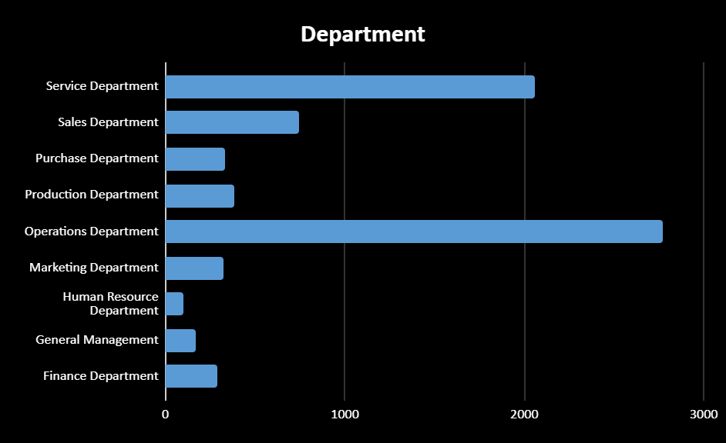
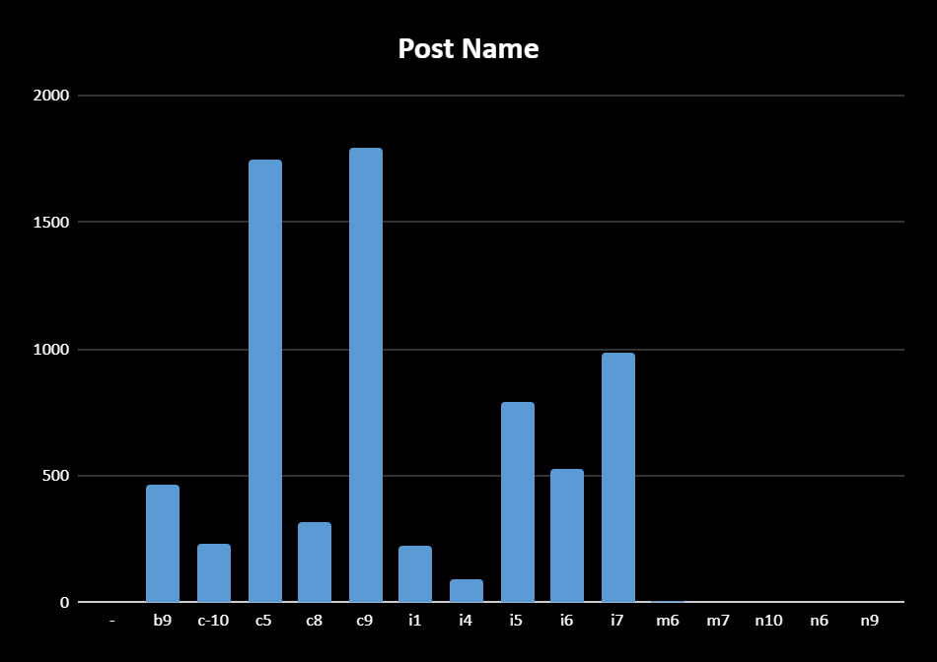
Here are some of the solutions
Hiring: Process of intaking people into an organization for different kinds of positions. How many males and females are Hired ?
Sol: The no. of males and females can be found using:
=COUNTIF(D2:D7169,"Male")
=COUNTIF(D2:D7169,"Female")
A. | Male Employes | 4085
 | Female Employees | 2675
5. Charts: Use different charts and graphs to perform the task representing the data. Represent different post tiers using a chart/graph?
Sol:
E. | Graph Showing Post Tiers:
For complete solution of Task 4: https://docs.google.com/document/d/17Ce_6eD-gHSnPVBlQ-93WAjhFVFvG-MCnmPG5DKNWuA/edit?usp=sharing

Slide 17
Final Projects
3.2
IMDB Movie Analysis
Bank Loan Case Study
XYZ Ads Airing Report
ABC Call Volume Trend

Slide 18
Final Project 1: IMDB Movie Analysis
The Final Project-1 is based on the IMDB movie review data collected over the years 1923 and 2016. This project is based on the concept of data analysis and pattern recognition. IMDB as we all know is one of the most trusted movie reviews which has been in the system for a long time now. Furthermore, in the given dataset the movies are compared using different fields which help us draw conclusions from the data and solve the questions asked.
Tasks or Assignments:
The project started with framing a problem statement by ourselves using our analytical skills and then developing a solution for it, hence the approach is simple, learning the cause of the problem in the first place. It is quite obvious that as we dig deeper into the problem the difficulty to answer increases exponentially. Since our target is to find the root cause of the problem, this brute force approach where we need to understand the data completely suits the best. All the given tasks can be solved one after the other, understanding the problem statement.
The tasks in this projects are:
Clean the given data
Movies with highest rating
Top 250
Best Directors
Popular Genres
Charts
MS-Excel was used complete this project.

Slide 19
Insights
All the problems refer to real-life situations which any data analyst would face while dealing with data. The attributes may differ but the application or approach will not change. Here we have only one dataset which shows different features of IMDB movie reviews. There happen to be around 5044 records categorized under various columns. The dataset is raw or not previously processed. It is basically unclean and needs to be pre-processed and cleaned thoroughly. This project has taught me how to vividly analyze the given data and use excel built-in functions with ease
Result/Follow:
https://docs.google.com/document/d/1DkvnIRRvOp4M8Q0n5wZcPW_iWaCVog8AX3JPRineH5g/edit?usp=sharing
https://docs.google.com/spreadsheets/d/1y1v_xyyEVgmGKiz6twdRV4t9QiPGqBJD/edit?usp=share_link&ouid=106348929162266263058&rtpof=true&sd=true

Slide 20
Final Project 2: Bank Loan Case Study
The Final Project-2 is based on a case study of Bank Loans. It is obvious that, when a loan application is received, the business must evaluate whether to approve the loan based on the applicant's profile. The bank's may be subjected to two different kinds of risks when a loan is approved: approving loans for those who cannot pay them back, not approving loans who can repay the loan. This project comprehends the same. We need to consider the previous data that the bank has recorded for the past years, analyze the data and then come up with an approach or a way to consider the details from the application and decide if we can approve the loan.
Tasks or Assignments:
Clean the data
Outliers
Imbalance in Data
Analysis:
a. Univariate Analysis
b.. Segmented Univariate Analysis
c. Bivariate Analysis
Correlation
Visualisation
Google Collaboratory was used to solve this project.

Slide 21
Insights
All the problems refer to real-life situations which any data analyst would face while dealing with data. The attributes may differ but the application or approach will not change.
Here we are dealing with a Bank Loan case study where banks usually find it challenging to decide whether to approve the bank loan or not.
There three different datasets which are given:
application_data:details of the application
previous_application: details of previous application
columns_description: Since both the datasets together have around 160 attributes this dataset contains the description of the attributes briefly.
Since the dataset “previous_application” has around 1.6 million records it was quite a task to work on EXCEL or Google sheets as their limit stops at 1 million.
Google’s Collaboratory was used to solve the entire task with ease.
Processing and working on such a huge dataset taught me a lot
Result/Follow:
https://docs.google.com/document/d/1KQgZNjat5Ucnk4AfmAS1htX1LYy03tnnGjUW5WaI8CM/edit?usp=sharing
https://colab.research.google.com/drive/17ucSLD9EOgxTt3pP42DGtPYOs1a7R8BC?usp=share_link

Slide 22
Final Project 3: XYZ Ads Airing Report Analysis
In order to grow a business's sales or enhance audience awareness of the goods or services, marketing and advertising play the most important roles in order to sell the company. As part of Final Project-3, the analyzed report of some companies’ ads for the year 2021 has been given. In the industry, it is believed that the first impression of any company can be shaped through the ads they air. The advertising industry is particularly cutthroat because many players would spend a lot of money to target the same market. Thus, they market in various methods. Advertisements can easily be stated as a step to convert the audience into consumers. In this project we are going to process the past data collected over airing different ads by different companies and derive meaningful insights and information in the process.
Tasks or Assignments:
What is Pod Position?
What is the share of various brands in TV airings and how has it changed from Q1 to Q4 in 2021?
Conduct a competitive analysis for the brands and define advertisement strategy of different brands and how it differs across the brands.
Mahindra and Mahindra wants to run a digital ad campaign to complement its existing TV ads in Q1 of 2022. Based on the data from 2021, suggest a media plan to the CMO of Mahindra and Mahindra. Which audience should they target? *Assume XYZ Ads has the ad viewership data and TV viewership for the people in India.
MS-Excel was used to solve this project.

Slide 23
Insights
All the problems refer to real-life situations which any data analyst would face while dealing with data. The attributes may differ but the application or approach will not change.
Here we are dealing with a dataset that is developed based on Ads aired by six different companies in the year of 2021
There were about 731785 records on the whole, 19 different attributes, 6 different companies.
The data helped in many types of analysis possible and draw insights
Result/Follow:
https://docs.google.com/document/d/1_u2bO6b6ha4q3TuaLtpagohbMZhFJC3wpumwRtz53Z4/edit?usp=sharing
https://docs.google.com/spreadsheets/d/1YjYwXzvGmOl_JIcbkO-sWK1SQP4AD0VC/edit?usp=share_link&ouid=106348929162266263058&rtpof=true&sd=true

Slide 24
Final Project 4: ABC Call Volume Trend Analysis
Businesses may have a local, regional, national, or international target audience, or a combination of them. Thus, they market in various methods. Advertising is a technique for promoting your company in order to boost sales or raise audience awareness of your goods or services. Your advertising may contribute to the formation of a customer's initial perceptions of your company before they interact with you directly and make a purchase of your goods or services. The advertising industry is particularly cutthroat because many players would spend a lot of money to target the same market. One of the many ways to improve the business is by taking insights from the customers also called the Customer Experience (CX). A customer experience (CX) team is made up of experts who examine data and consumer input before sharing their findings with the rest of the company. These teams typically carry out a variety of duties to analyze Customer Experience Data.
Tasks or Assignments:
Calculate the average call time duration for all incoming calls received by agents (in each Time_Bucket).
Show the total volume/ number of calls coming in via charts/ graphs [Number of calls v/s Time]. You can select time in a bucket form (i.e. 1-2, 2-3, …..)
As you can see, the current abandonment rate is approximately 30%. Propose a manpower plan required during each time bucket [between 9am to 9pm] to reduce the abandon rate to 10%..
Let’s say customers also call this ABC insurance company at night but don't get an answer as there are no agents to answer, this creates a bad customer experience for this Insurance company.
MS-Excel was used to solve this project.

Slide 25
Insights
All the problems refer to real-life situations which any data analyst would face while dealing with data. The attributes may differ but the application or approach will not change.
The dataset in this project refers to calls an insurance company has received at different times of the day, the duration it lasted and many other attributes.
There are about 117989 records and about 14 attributes.
It all accounts for the Customer Experience [CX] and the stats that are derived from the dataset are really helpful to get the solutions for the questions.
The data helped in many types of analysis possible and draw insights
Result/Follow:
https://docs.google.com/document/d/1gtk_RMoDxNRZ1OAJ2wg2jJx7oudzuQVjR_Rdimm21fQ/edit?usp=sharing
https://docs.google.com/spreadsheets/d/18PQGCKHxZiuYxUbLQ9KCSCEs09j2xiLo/edit?usp=share_link&ouid=106348929162266263058&rtpof=true&sd=true

Slide 26
Summary
04

Slide 27
Summary
To recapitulate, Data Analysis is the process of modifying, processing, and cleaning raw data in order to obtain useful, pertinent information that supports commercial decision-making. The process offers helpful insights and statistics, frequently presented in charts, graphics, tables, and graphs, which lessen the risks associated with decision-making. Every time we make a decision in our daily lives, we can observe a simple illustration of data analysis by assessing what has happened in the past or what will happen if we take that action. In its simplest form, this process involves looking at the past or future and making a choice based on that analysis.
Why is Data Analysis Important?
Better Customer Targeting
You will know your target customers better
Reduce operational costs
Better problem solving methods
You get more accurate data
Finally, Data Analysis has been used in many industries such as Artificial Intelligence, Machine Learning also it has been a great asset by largely helping the Researchers in all areas for easy and thorough scrutiny to derive meaningful and helpful insights.

Slide 28
Thank You!
Let’s Connect!!
shreejit.jithu2002@gmail.com
8008299265
https://www.linkedin.com/in/shreejit-cheela
Please keep this slide for attribution

